Slide 1
Making Sense of Ashesi Website Uptime Data
Kpetermeni Siakor

Slide 2
Data Sources
Pingdom.com
Dr. Charles Jackson

Slide 3
Nature of Data
10 Geographically Dispersed Probe Servers
Probing data from each minute: exactly at the 56th second by loading the most basic server response.
395,166 entries covering June 26, 2014 – April 1, 2015

Slide 4
Research Questions
Which probe servers have the fastest link to the Ashesi website?
Where is the Ashesi website located?
Where are the probe servers located?
What hour (s) of the day have the fastest response times?
What is the total uptime during the period?
Can we tell if the Ashesi website was moved from one server to the other in the period under review?

Slide 5
Process
Data collection from Dr. Jackson and Pingdom.com
Data cleaning in MS Excel 2013
Measures of Centrality in Excel and R
IP Geolocation using CartoDB

Slide 6
Server Uptime
99.48604 %
# Setting Variables
numRows = length(numdom$ResponseTime);
# Determining Uptime Percentage
upTimes <- numdom$Status;
upTimes
upTime <- sum(upTimes == 1)
upTimePercentage <- (upTime / numRows)*100;
upTimePercentage

Slide 7
Probing Location with Best Response

Slide 8
Hour of Day With Best Response

Slide 9
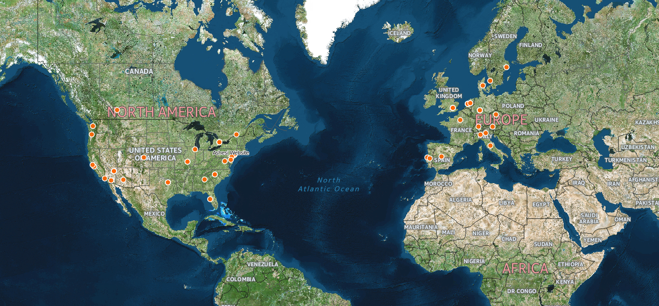
Probe Servers

Slide 10
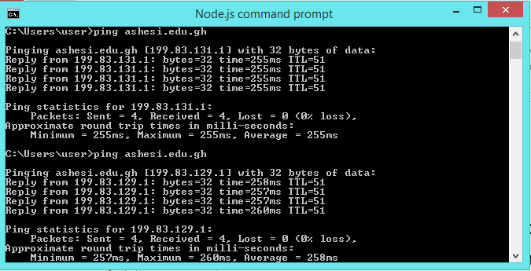
Ashesi’s Server Address is Dynamic!

Slide 11
Conclusions
The physical location of the probe servers have no effect on the link speed to the Ashesi webhost.
Ashesi’s website is getting less than 99.5% uptime.
Not enough information to conclude that Ashesi’s website moved.
11pm each day is the fastest time to get to the Ashesi website

Slide 12
Sources
CartoDB: https://mobdevsec.cartodb.com
Pingdom.com: https://my.pingdom.com/probes/feed

